Slide 1
The Perfect Weekend

Slide 2
Elevator pitch
A perfect getaway requires a lot of planning and researching, which can be overwhelming.
Whether you are looking for an adventure-packed trip or a tour that’s full of cuisine and entertainment, we’ve got you covered.
Say goodbye to endless searches, and hello to stress-free travel and user-friendly application with The Perfect Weekend.

Slide 3
Concept

Slide 4
Description
The Perfect Weekend is an application that gives users the ability to find restaurants, activities and points of interests in a desired location to help plan the perfect getaway.

Slide 5
Motivation for development?
Since we all love a little getaway from time to time, we want to create an application that allow us to find food and activities in the area we want go and able to find images and informations about those places to help plan our trips.

Slide 6
User Stories
When user provides the city that they want to visit in the search bar Then user is presented with 3 days weather forecast for the location, along with list of activities and restaurant recommendations | When user clicks on filter by button, Then user sees the options of filter to sort data how they want
When user chooses the activity of interest Then they see list of options of that activity | When user navigate to about page Then user is presented with informations of the website creators
When user hovers over hamburger nav bar Then users sees drop down menu and able to navigate around the website | When the user reaches the bottom of the page, Then the page loads more results based on search criteria
When user clicks on the desired activity/restaurant Then user is provided with images, title, ratings, price, description and reviews
When user decided on the activity that they want to do Then user can heart the activity to save the activity to the favorite page
When user goes to contact page Then user can fill the form to contact our team
When user scrolls to the footer and click on GitHub button, Then user can see our repository on GitHub

Slide 7
Process

Slide 8
Technologies Used
Yelp API: Access different categories and contents based on user’s preferences
Open Weather Map API: Grab location and weather
Google Drive: Brainstorming and Presentation
GitHub: Coding collaboration
BULMA: Frontend framework and styling

Slide 9
Breakdown of Tasks and Roles
Homepage was done by Tram Le
Results page was done by Zachary Cygan
Weather and favorites page was done by Daniel Hernandez
Search filter and styling done by Mona Lee
Single detailed view of card done by Shawn Lapuz

Slide 10
Successes
Challenges
Git merge conflicts
API rate limits
Time management
Technical difficulties

Slide 11
Successes
Responsive design
Collaborative effort
Good communication from all members

Slide 12
Demo

Slide 13
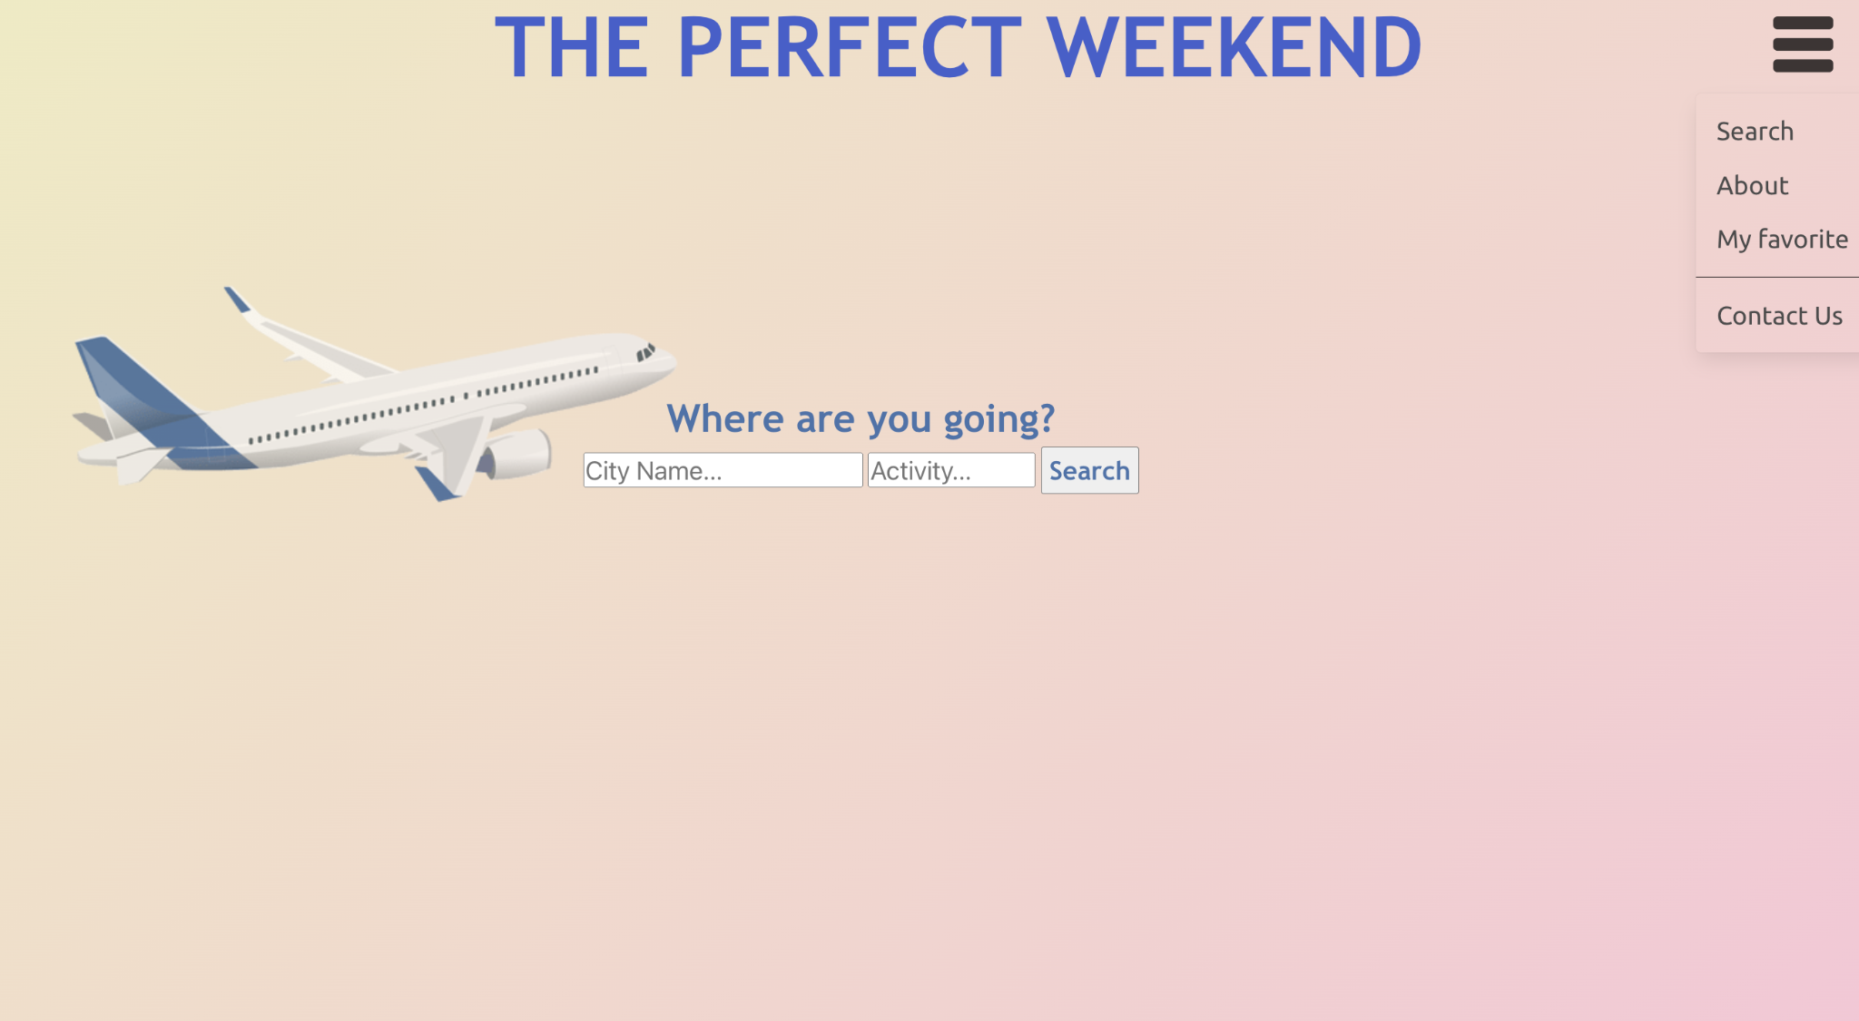
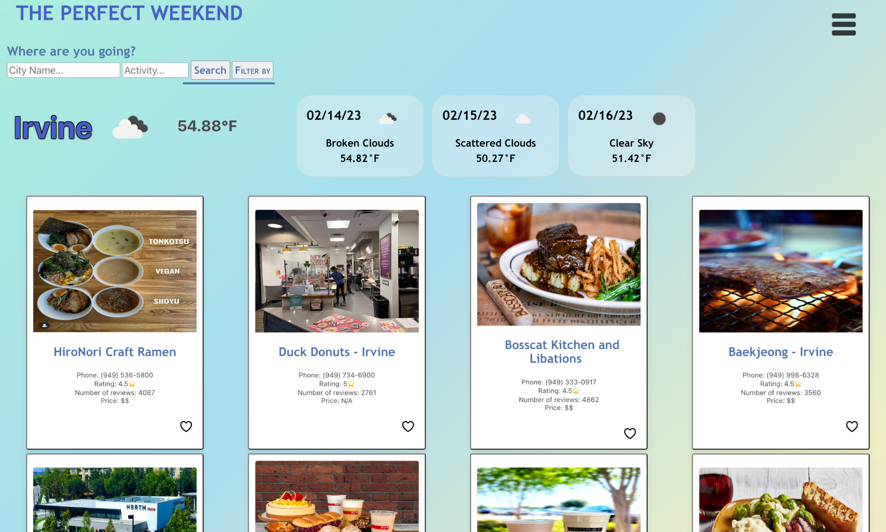
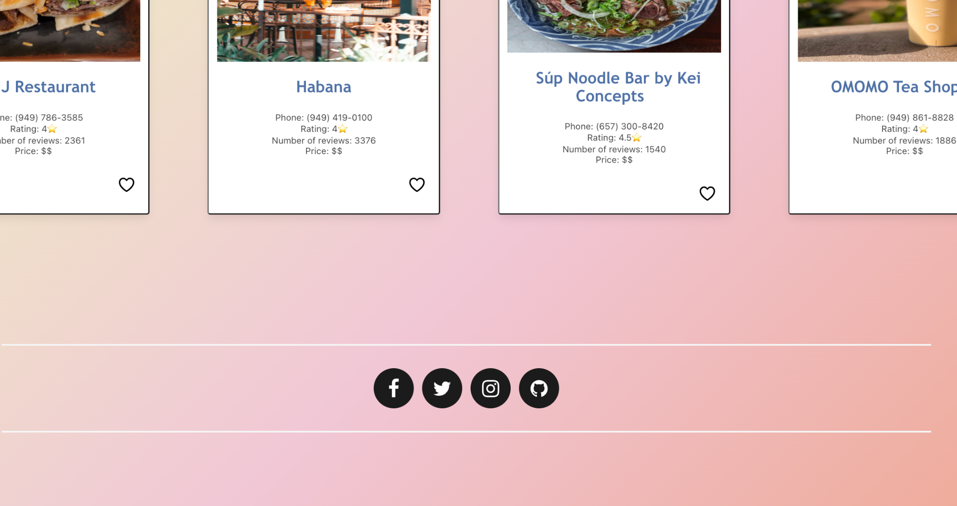
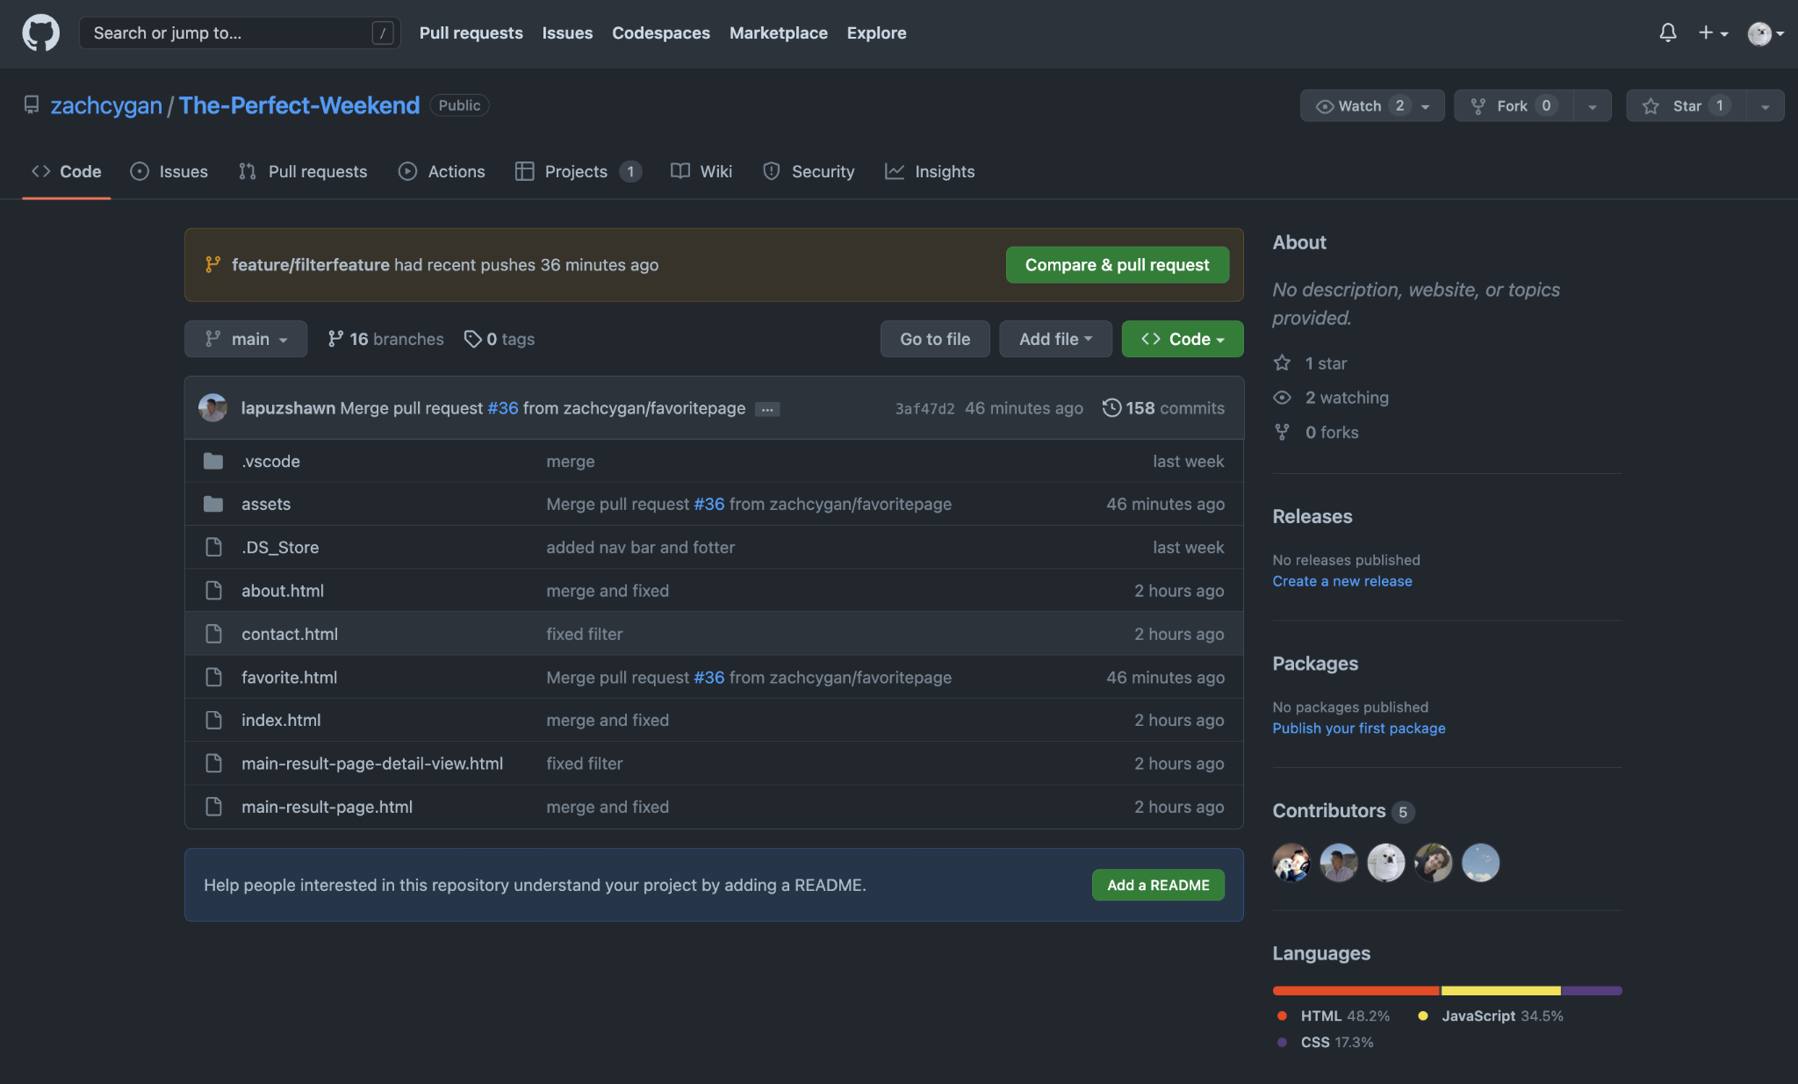

Slide 14
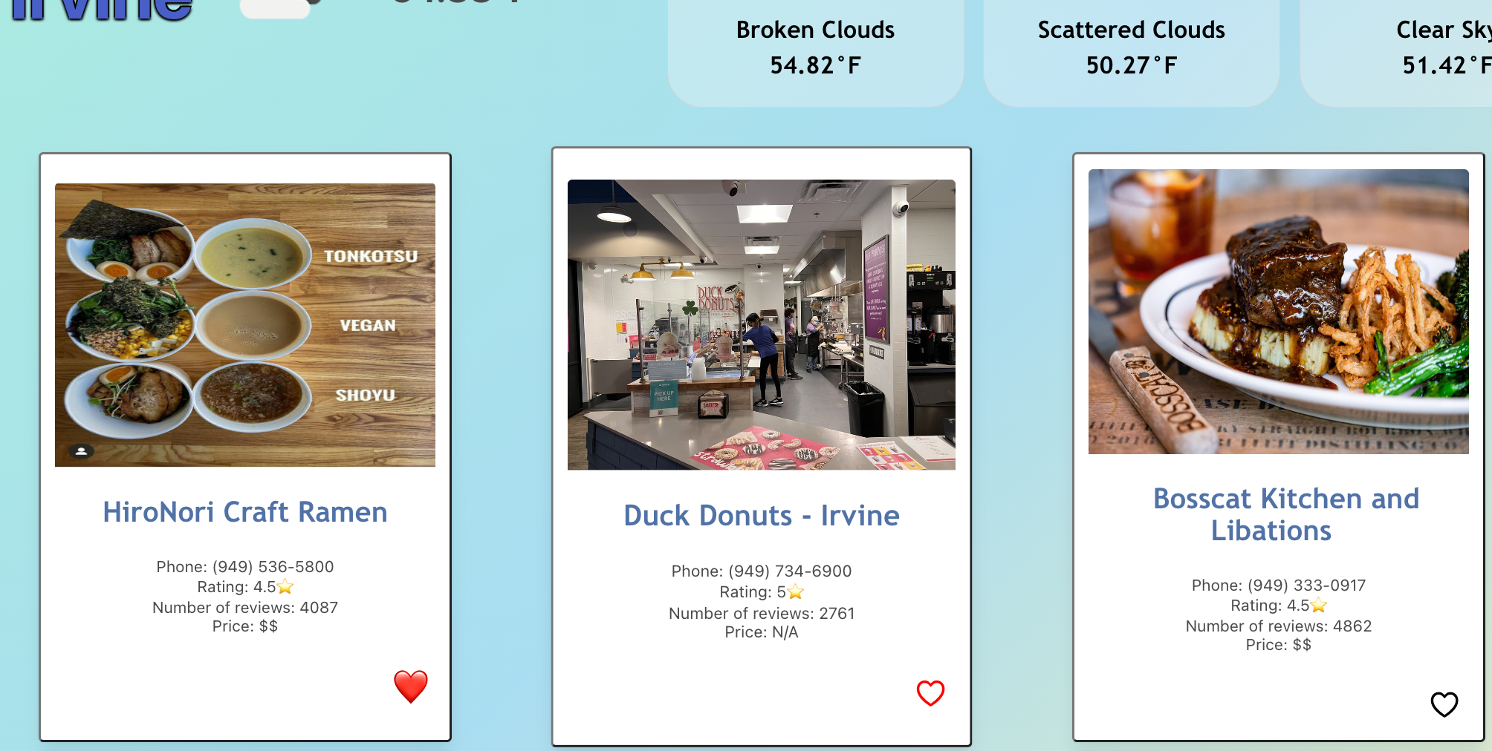
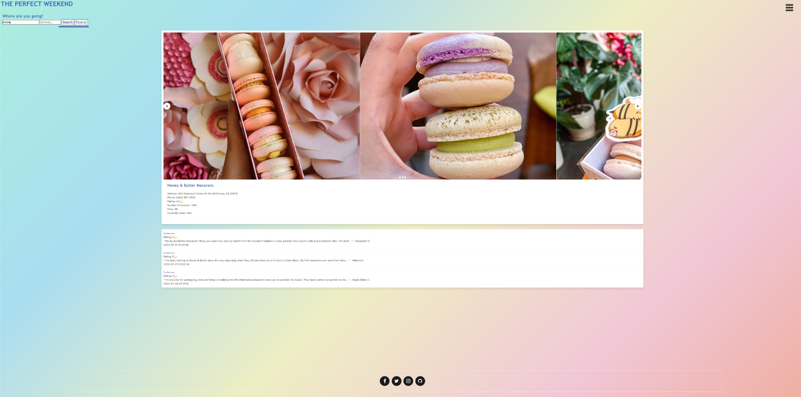

Slide 15
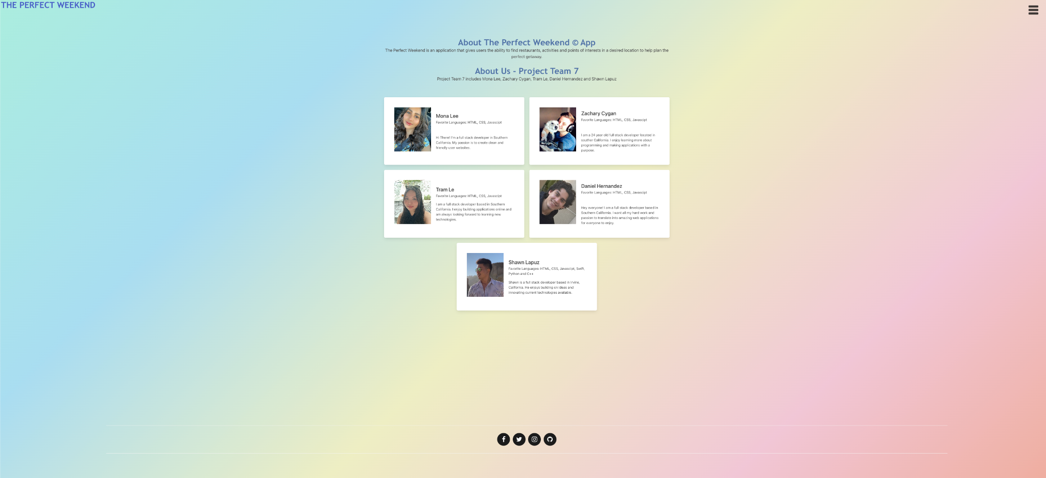
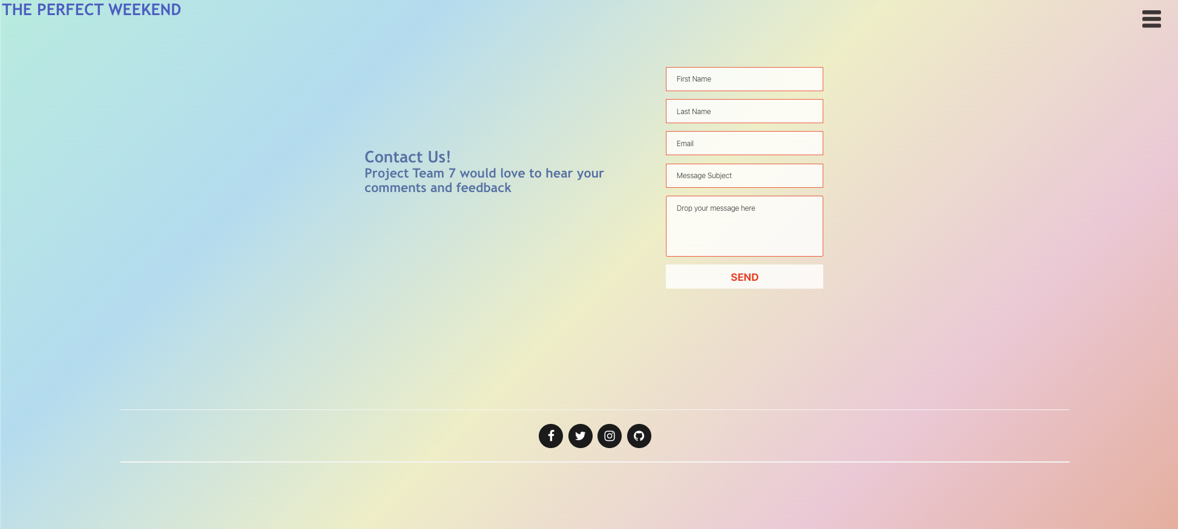

Slide 16
Directions for Future Development
For future development, we are hoping to be able to get users to create accounts on our application to be able save their favorites to server and also create personal itinerary

Slide 17
Links
Deployed
GitHub repo
https://zachcygan.github.io/The-Perfect-Weekend/
https://github.com/zachcygan/The-Perfect-Weekend

